Slide 1

Bounding
John Nganga

Slide 2
You’re HERE

Slide 3
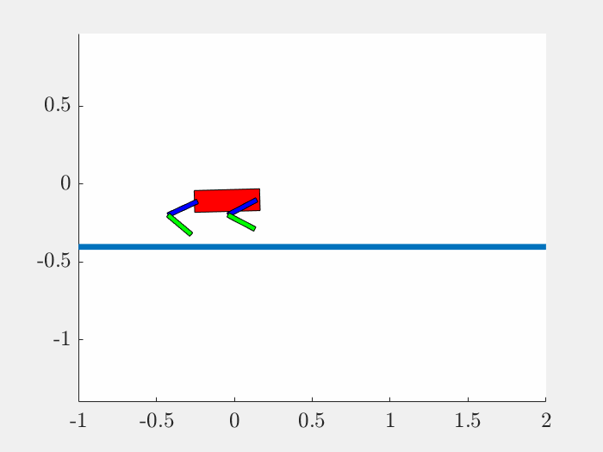
Choosing not to noise state Traj

Slide 4

Motion
iLQR
Explicit DDP
Bounding with vx = 0.5

Slide 5
Motion
ExtMod DDP
Tensor DDP

Slide 6
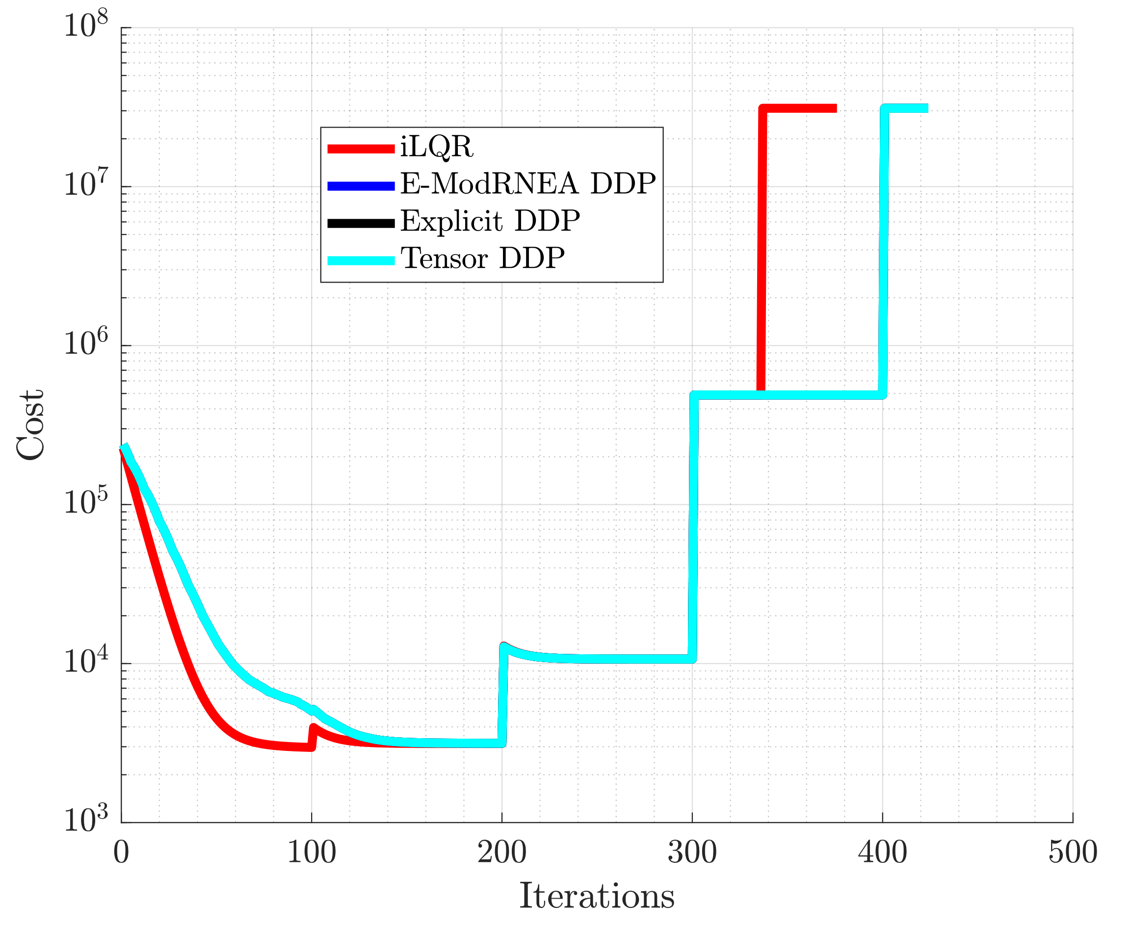
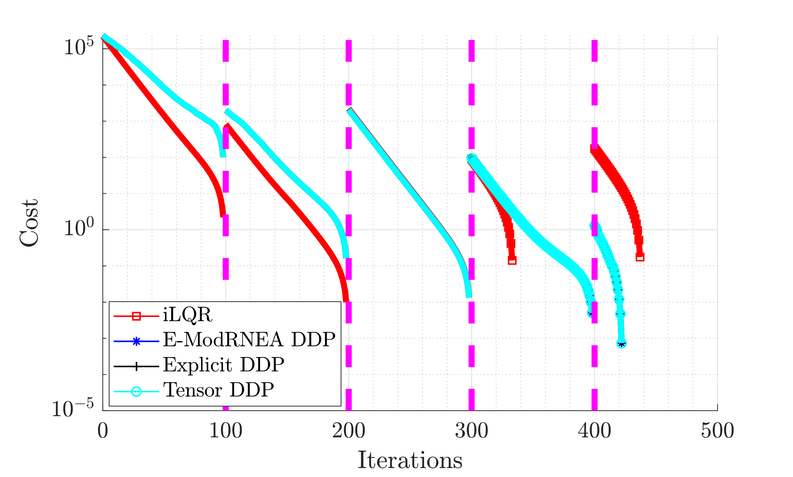
Cost

Slide 7
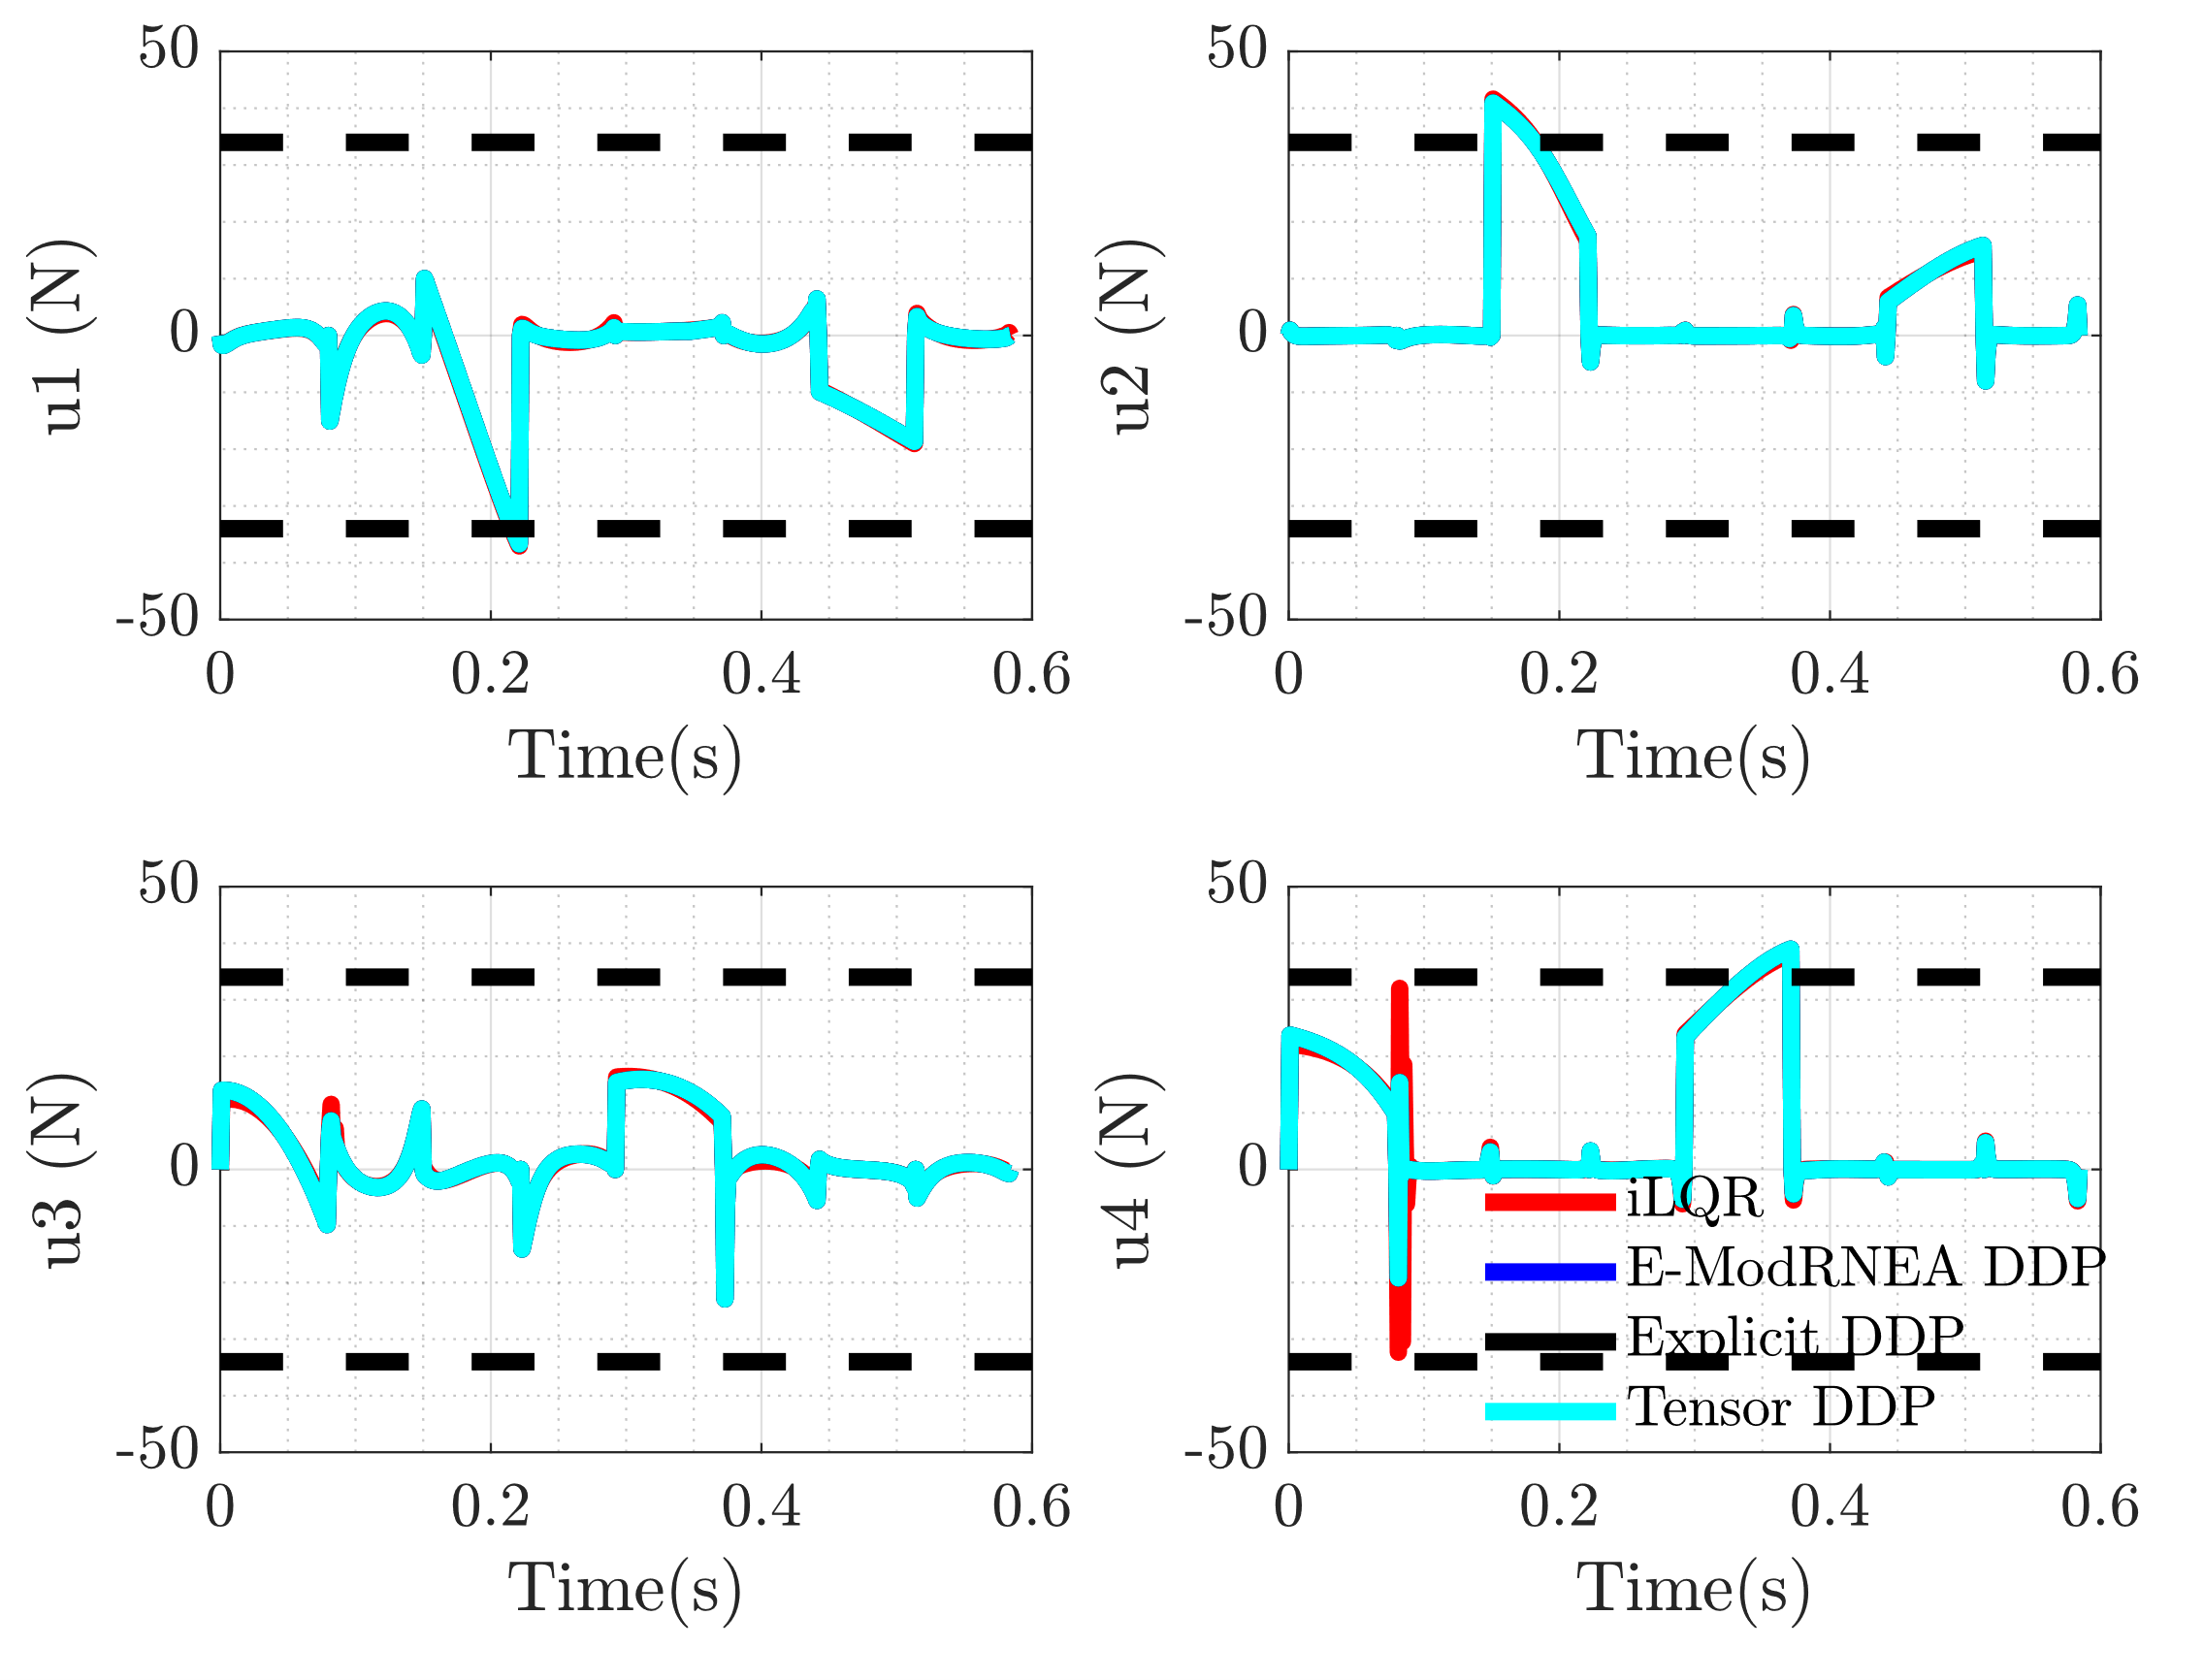
Control

Slide 8
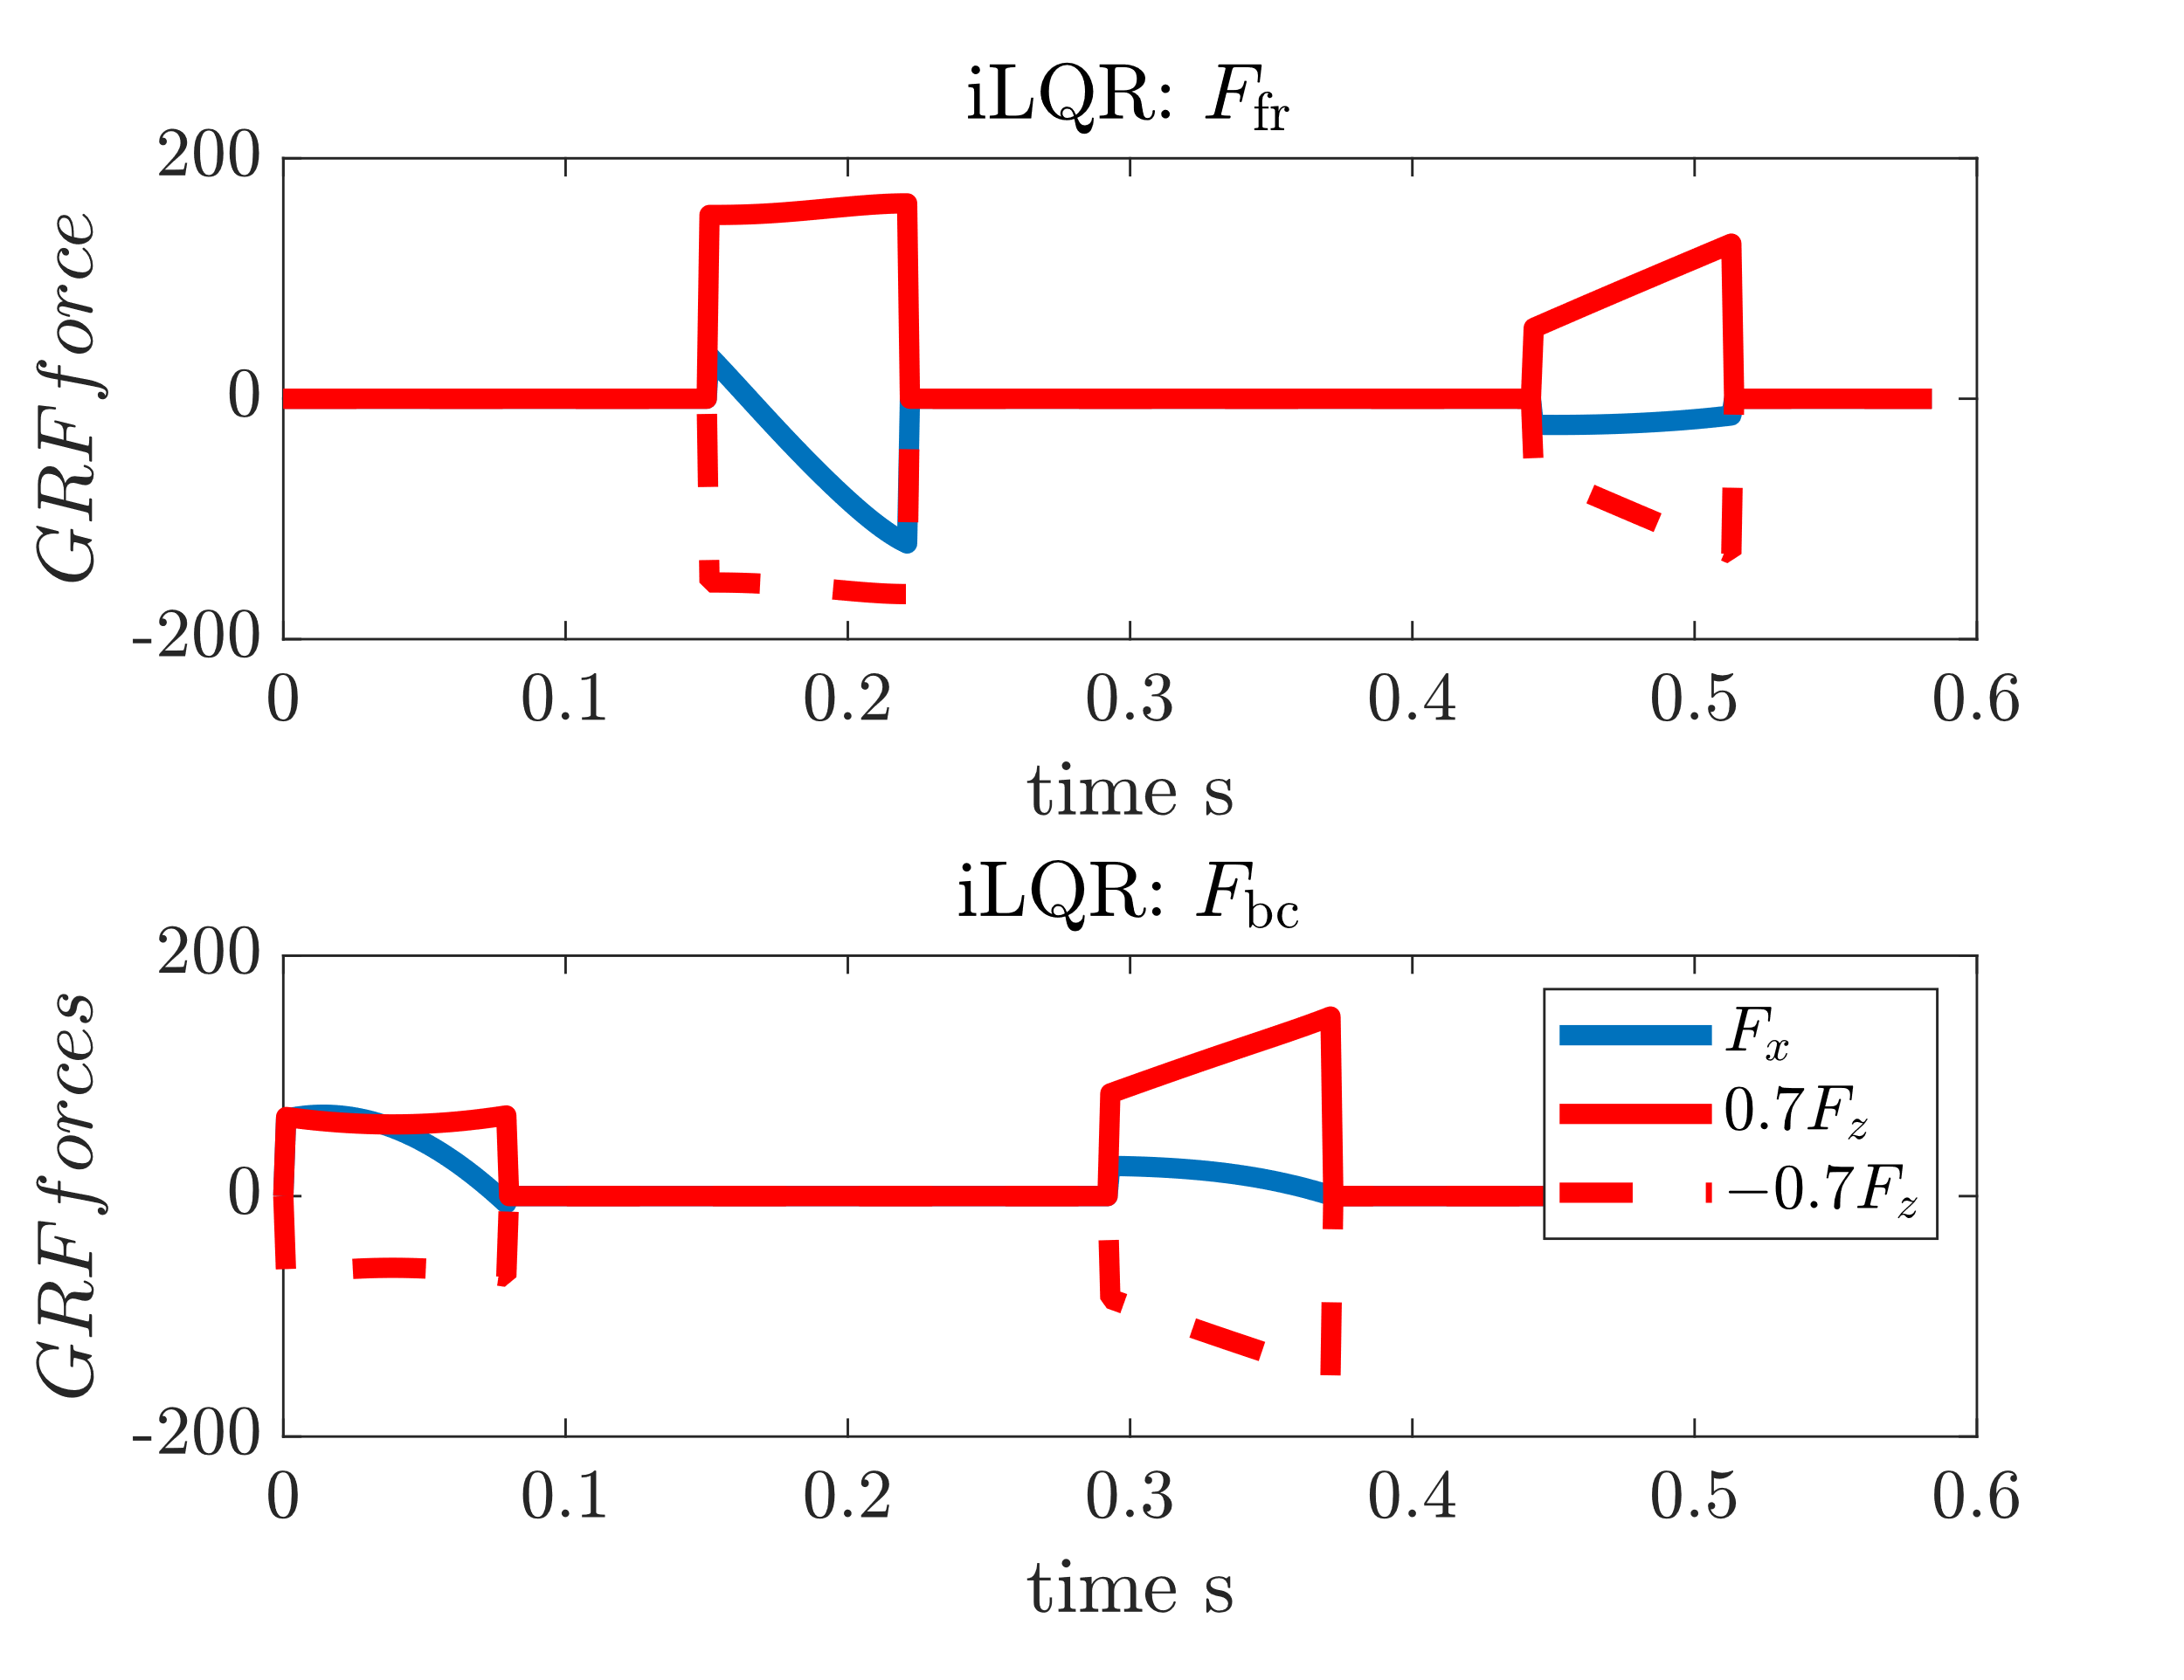

GRFs

Slide 9
Add noise to Optimized Control Trajectory
Use optimized trajectory and control as initial guess
Add weiner noise to controller
Run either iLQR/DDP for 20 iterations
Noise scaling
scaler = linspace(-2,2,15);
N = 585; dt = 1e-3;
dW = sqrt(dt)*randn(4,N); %weiner noise
W = cumsum(dW) * scaler(i);

Slide 10
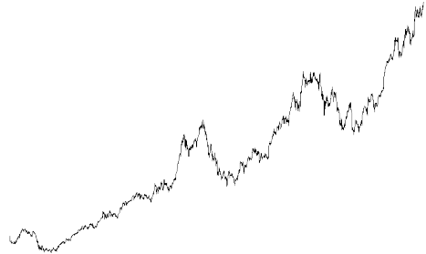
Add Noise to Trajectory
Trajectory
Control
Initial
Intermediate
Optimal
Control
Trajectory
Noise * Scalar
Run either iLQR/DDP for 20 iterations

Slide 11
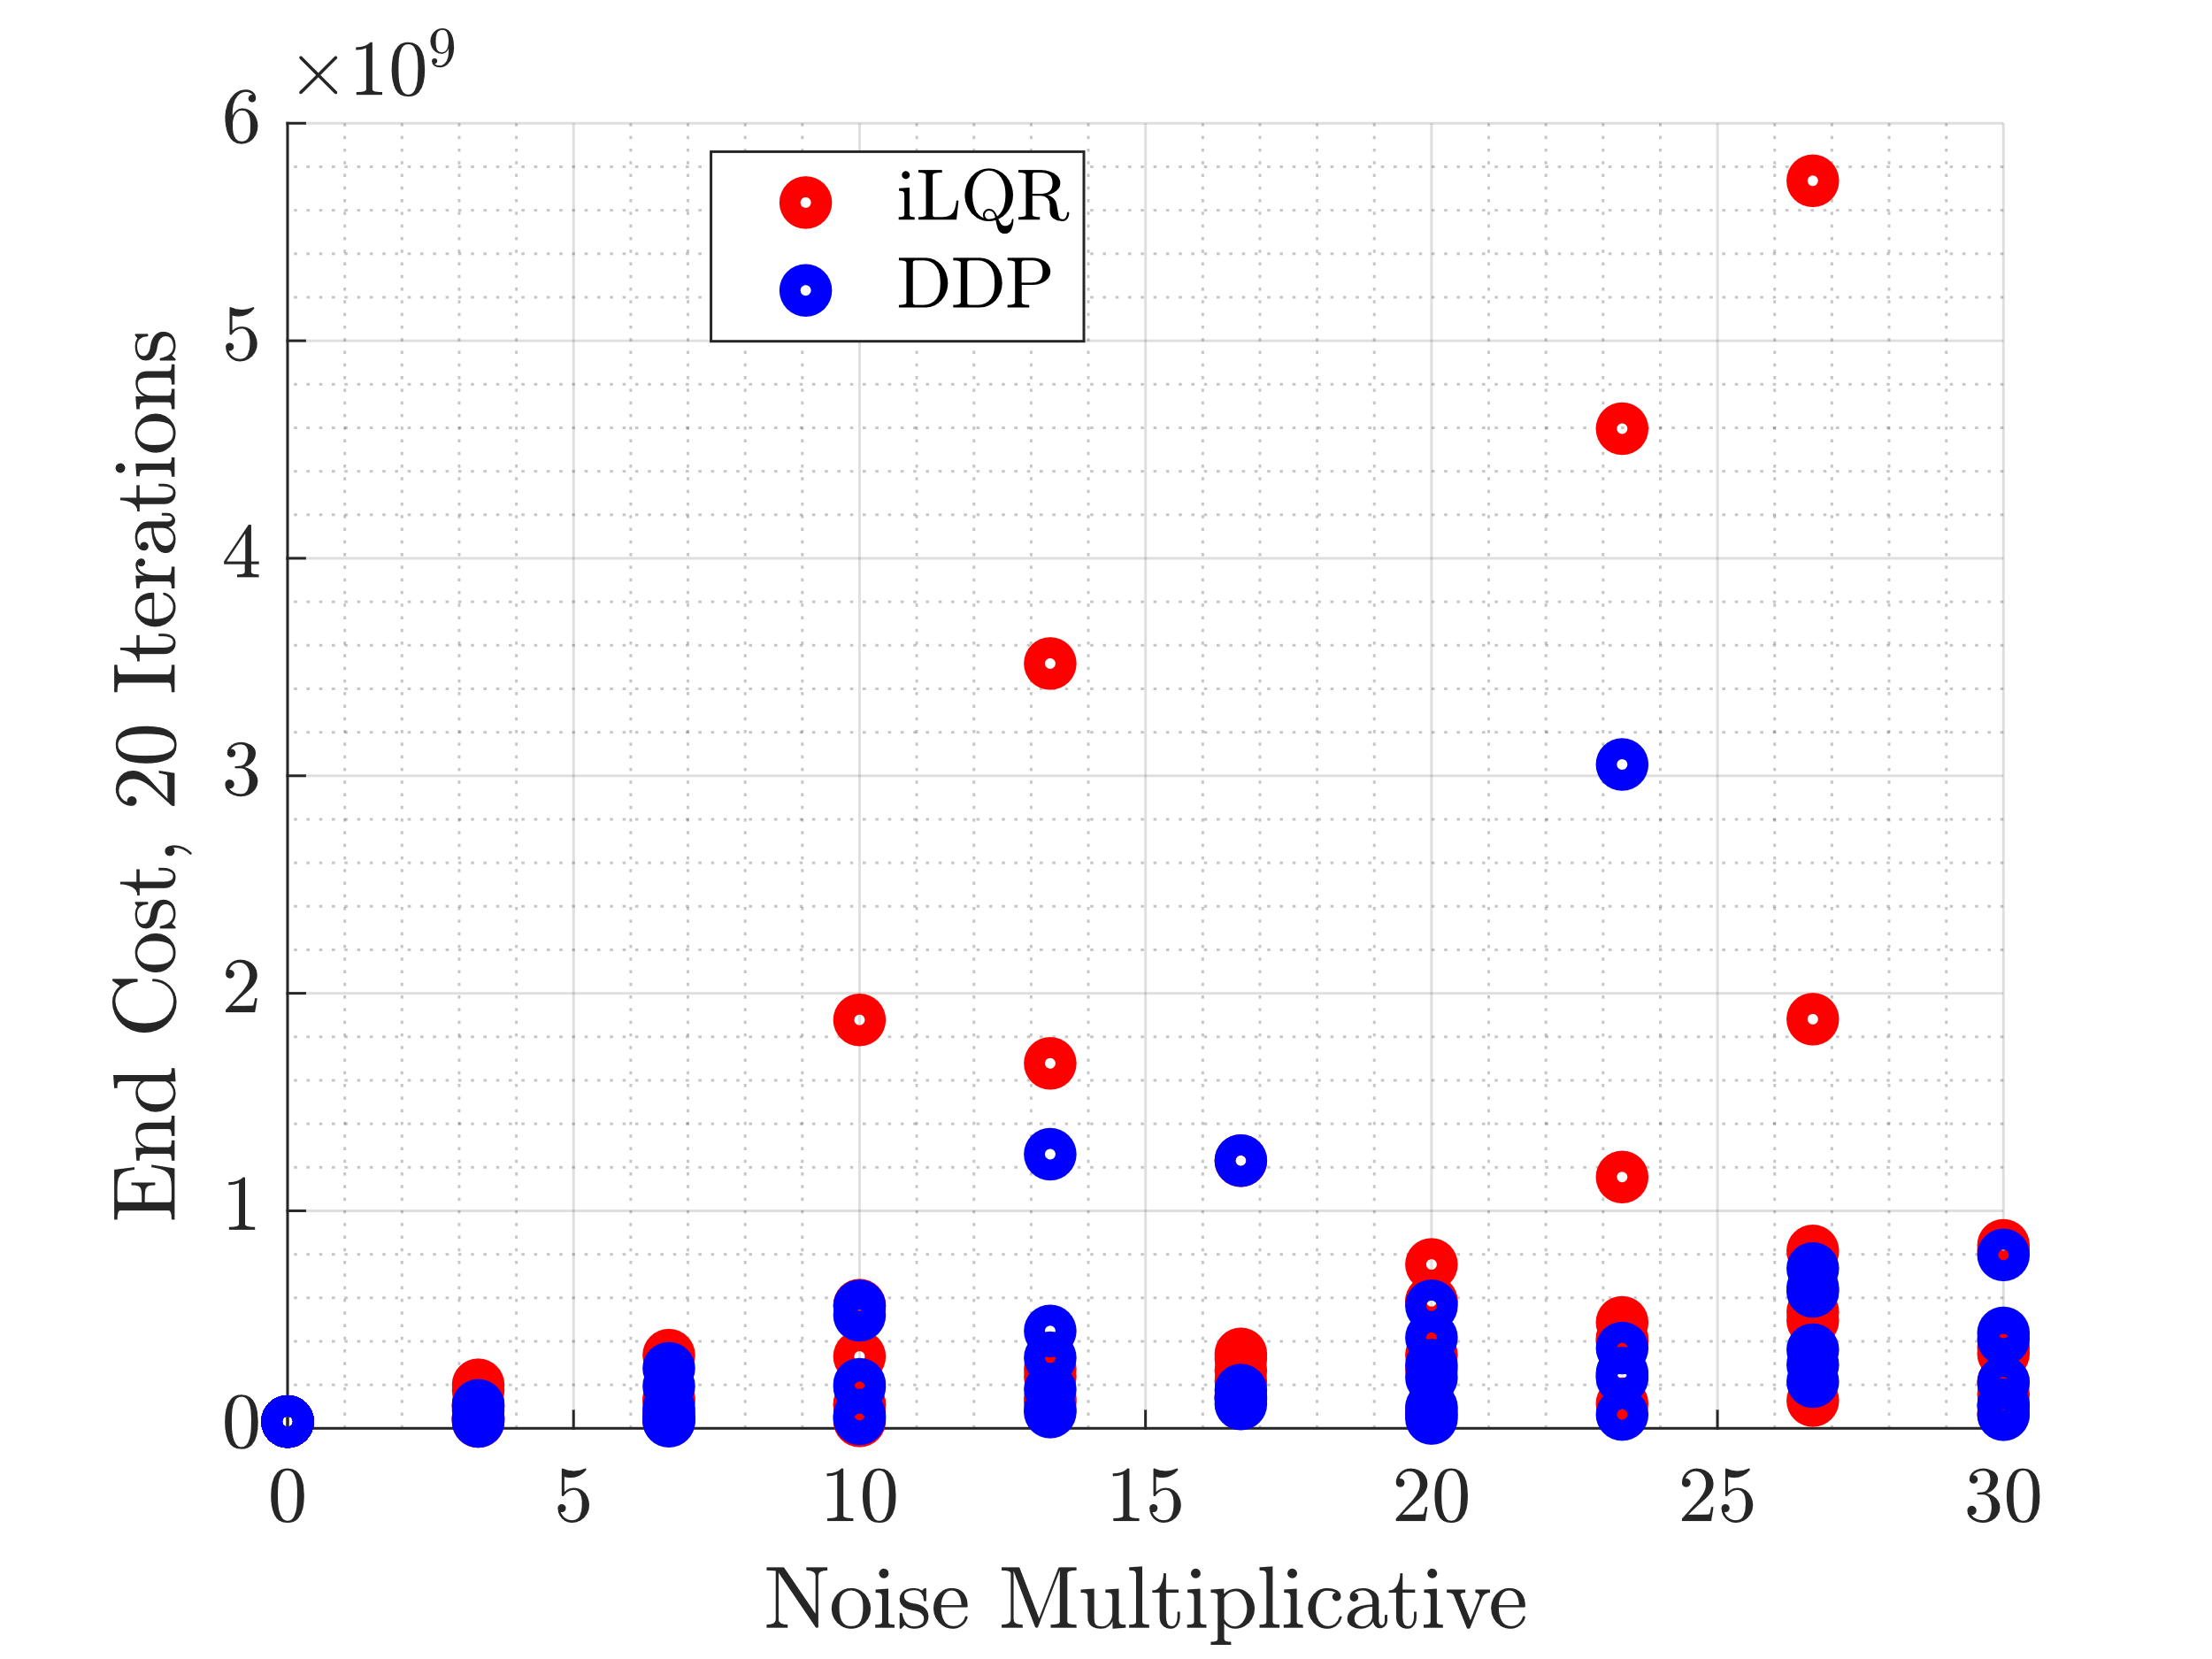
End Cost

Slide 12
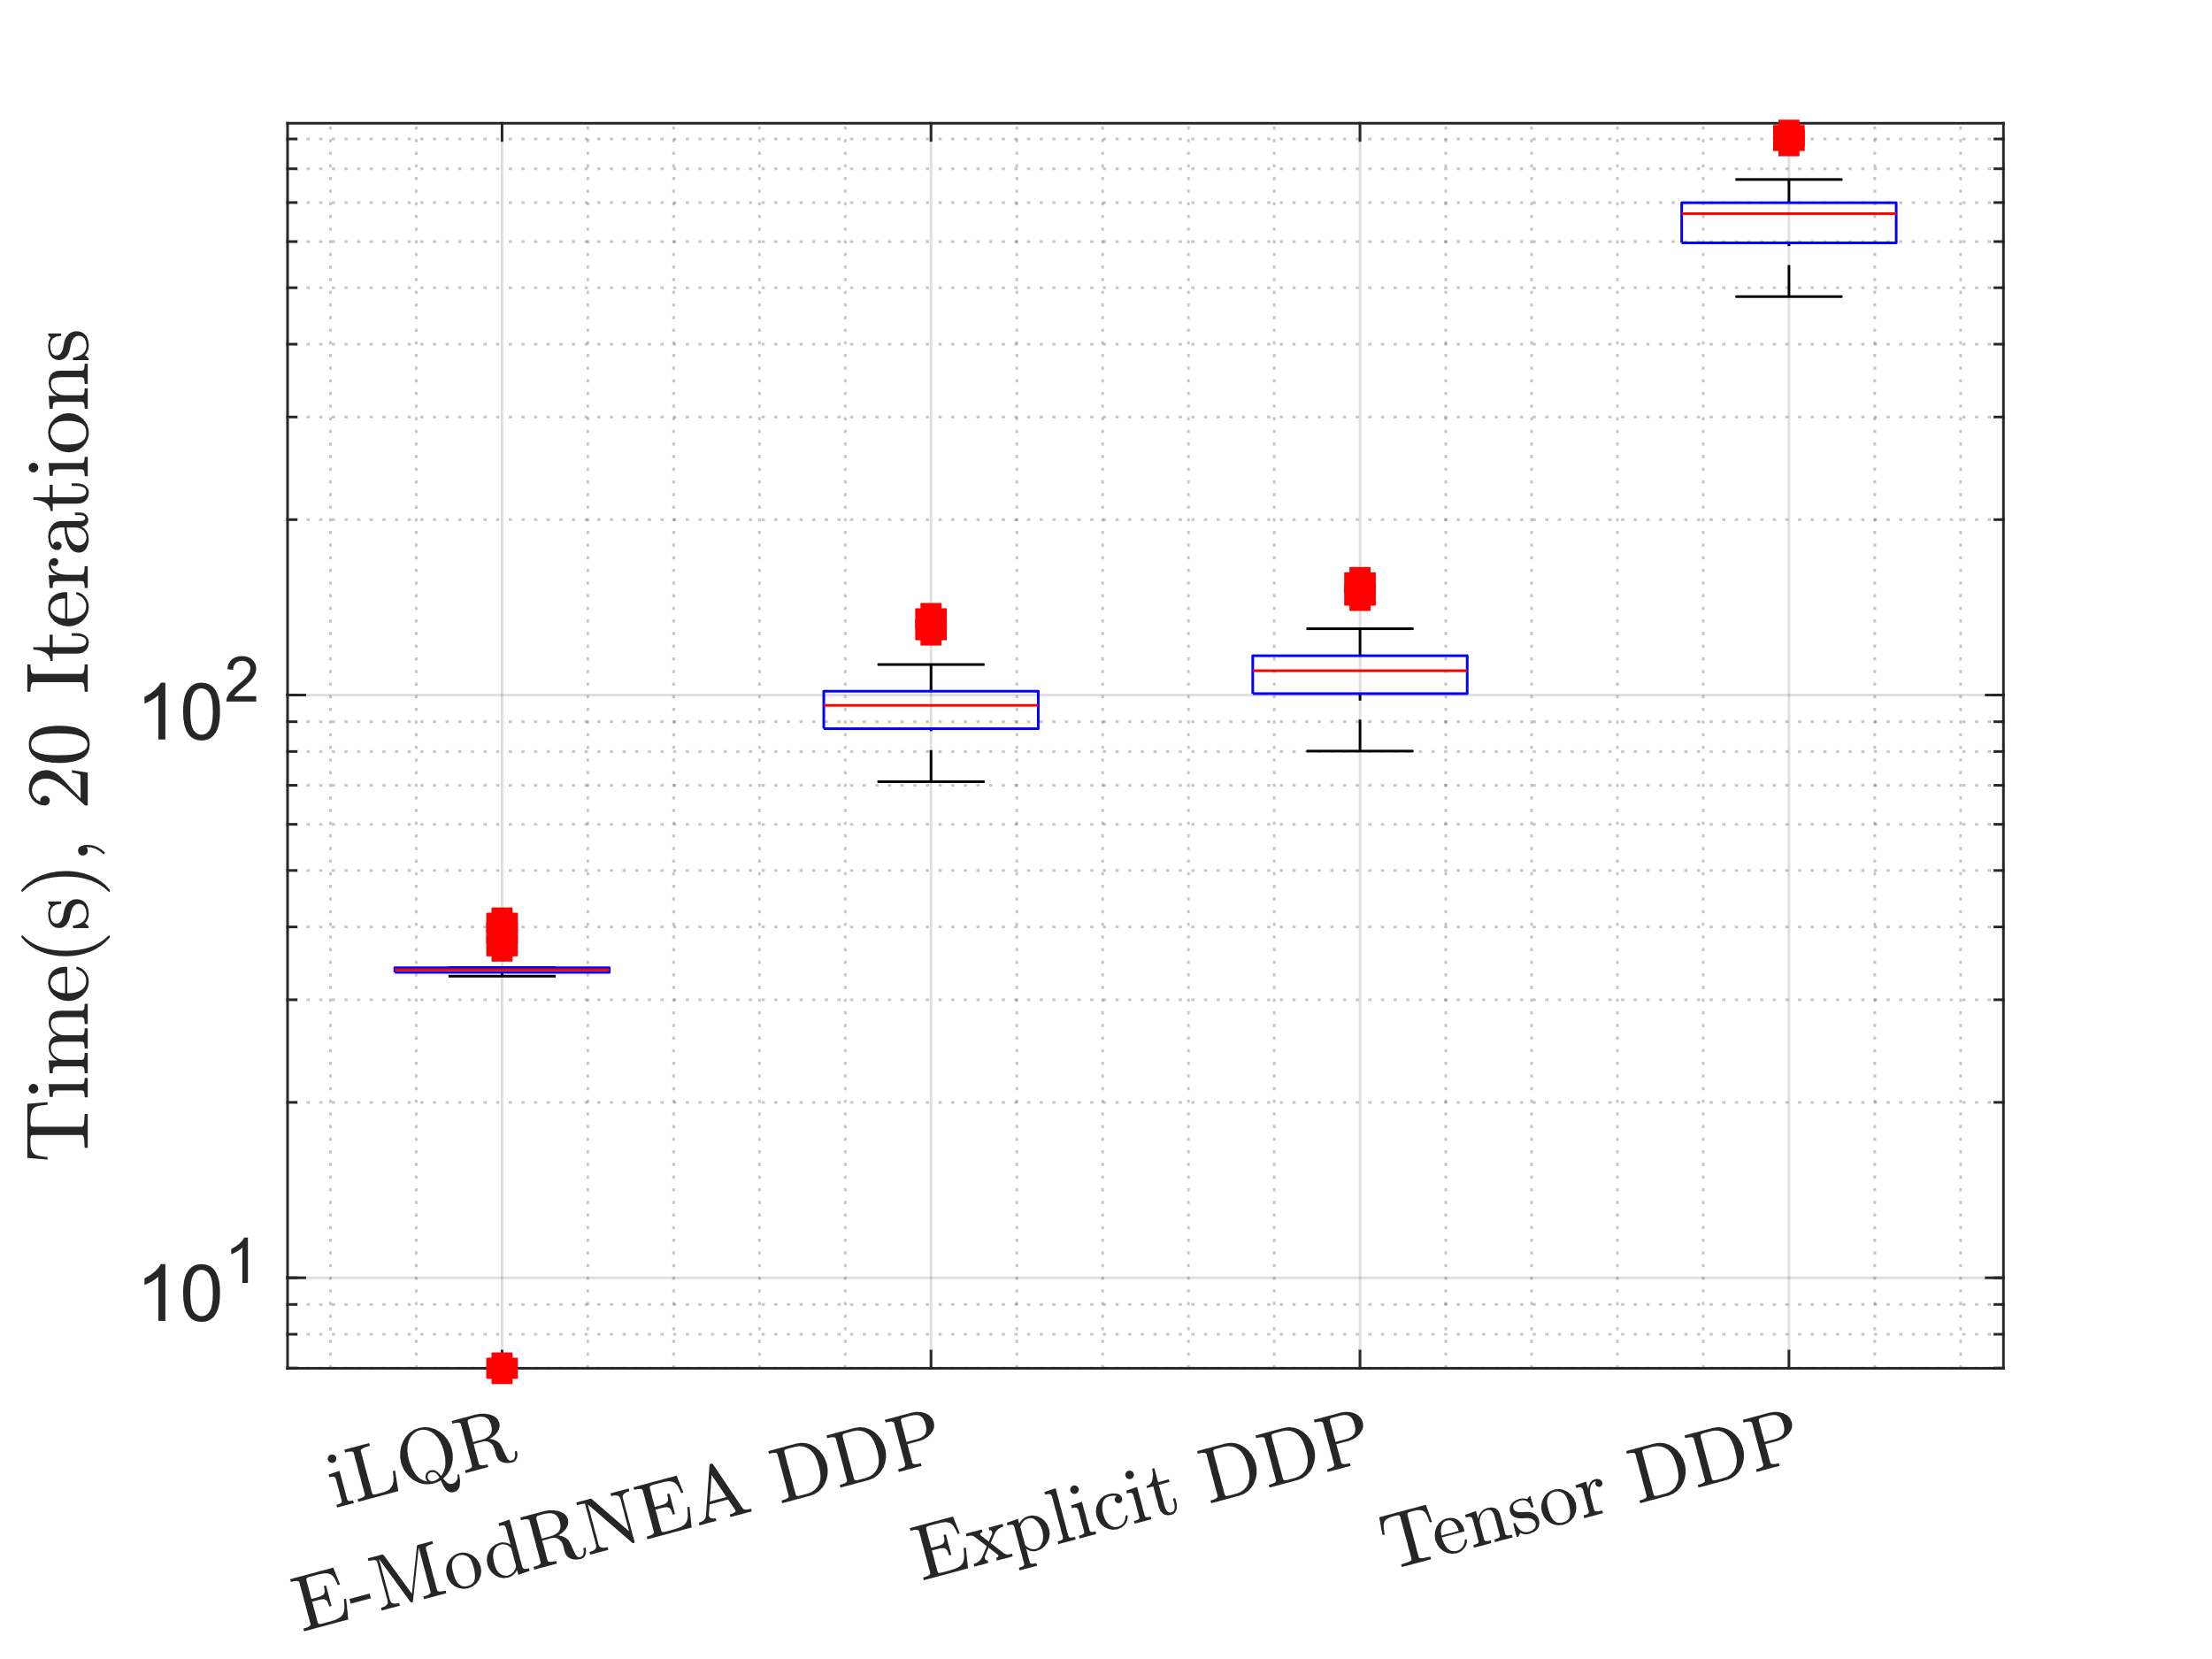
Time

Slide 13
Add noise to control
Use optimized trajectory and control as initial guess
Add weiner noise to controller
Run either iLQR/DDP for 150 iterations
Noise
N = 585; dt = 1e-3;
dW = sqrt(dt)*randn(4,N); %weiner noise
W = cumsum(dW);

Slide 14
Add Noise to Trajectory
Trajectory
Control
Initial
Intermediate
Optimal
Control
Trajectory
Noise * Large Scalar
Run either iLQR/DDP to convergence

Slide 15
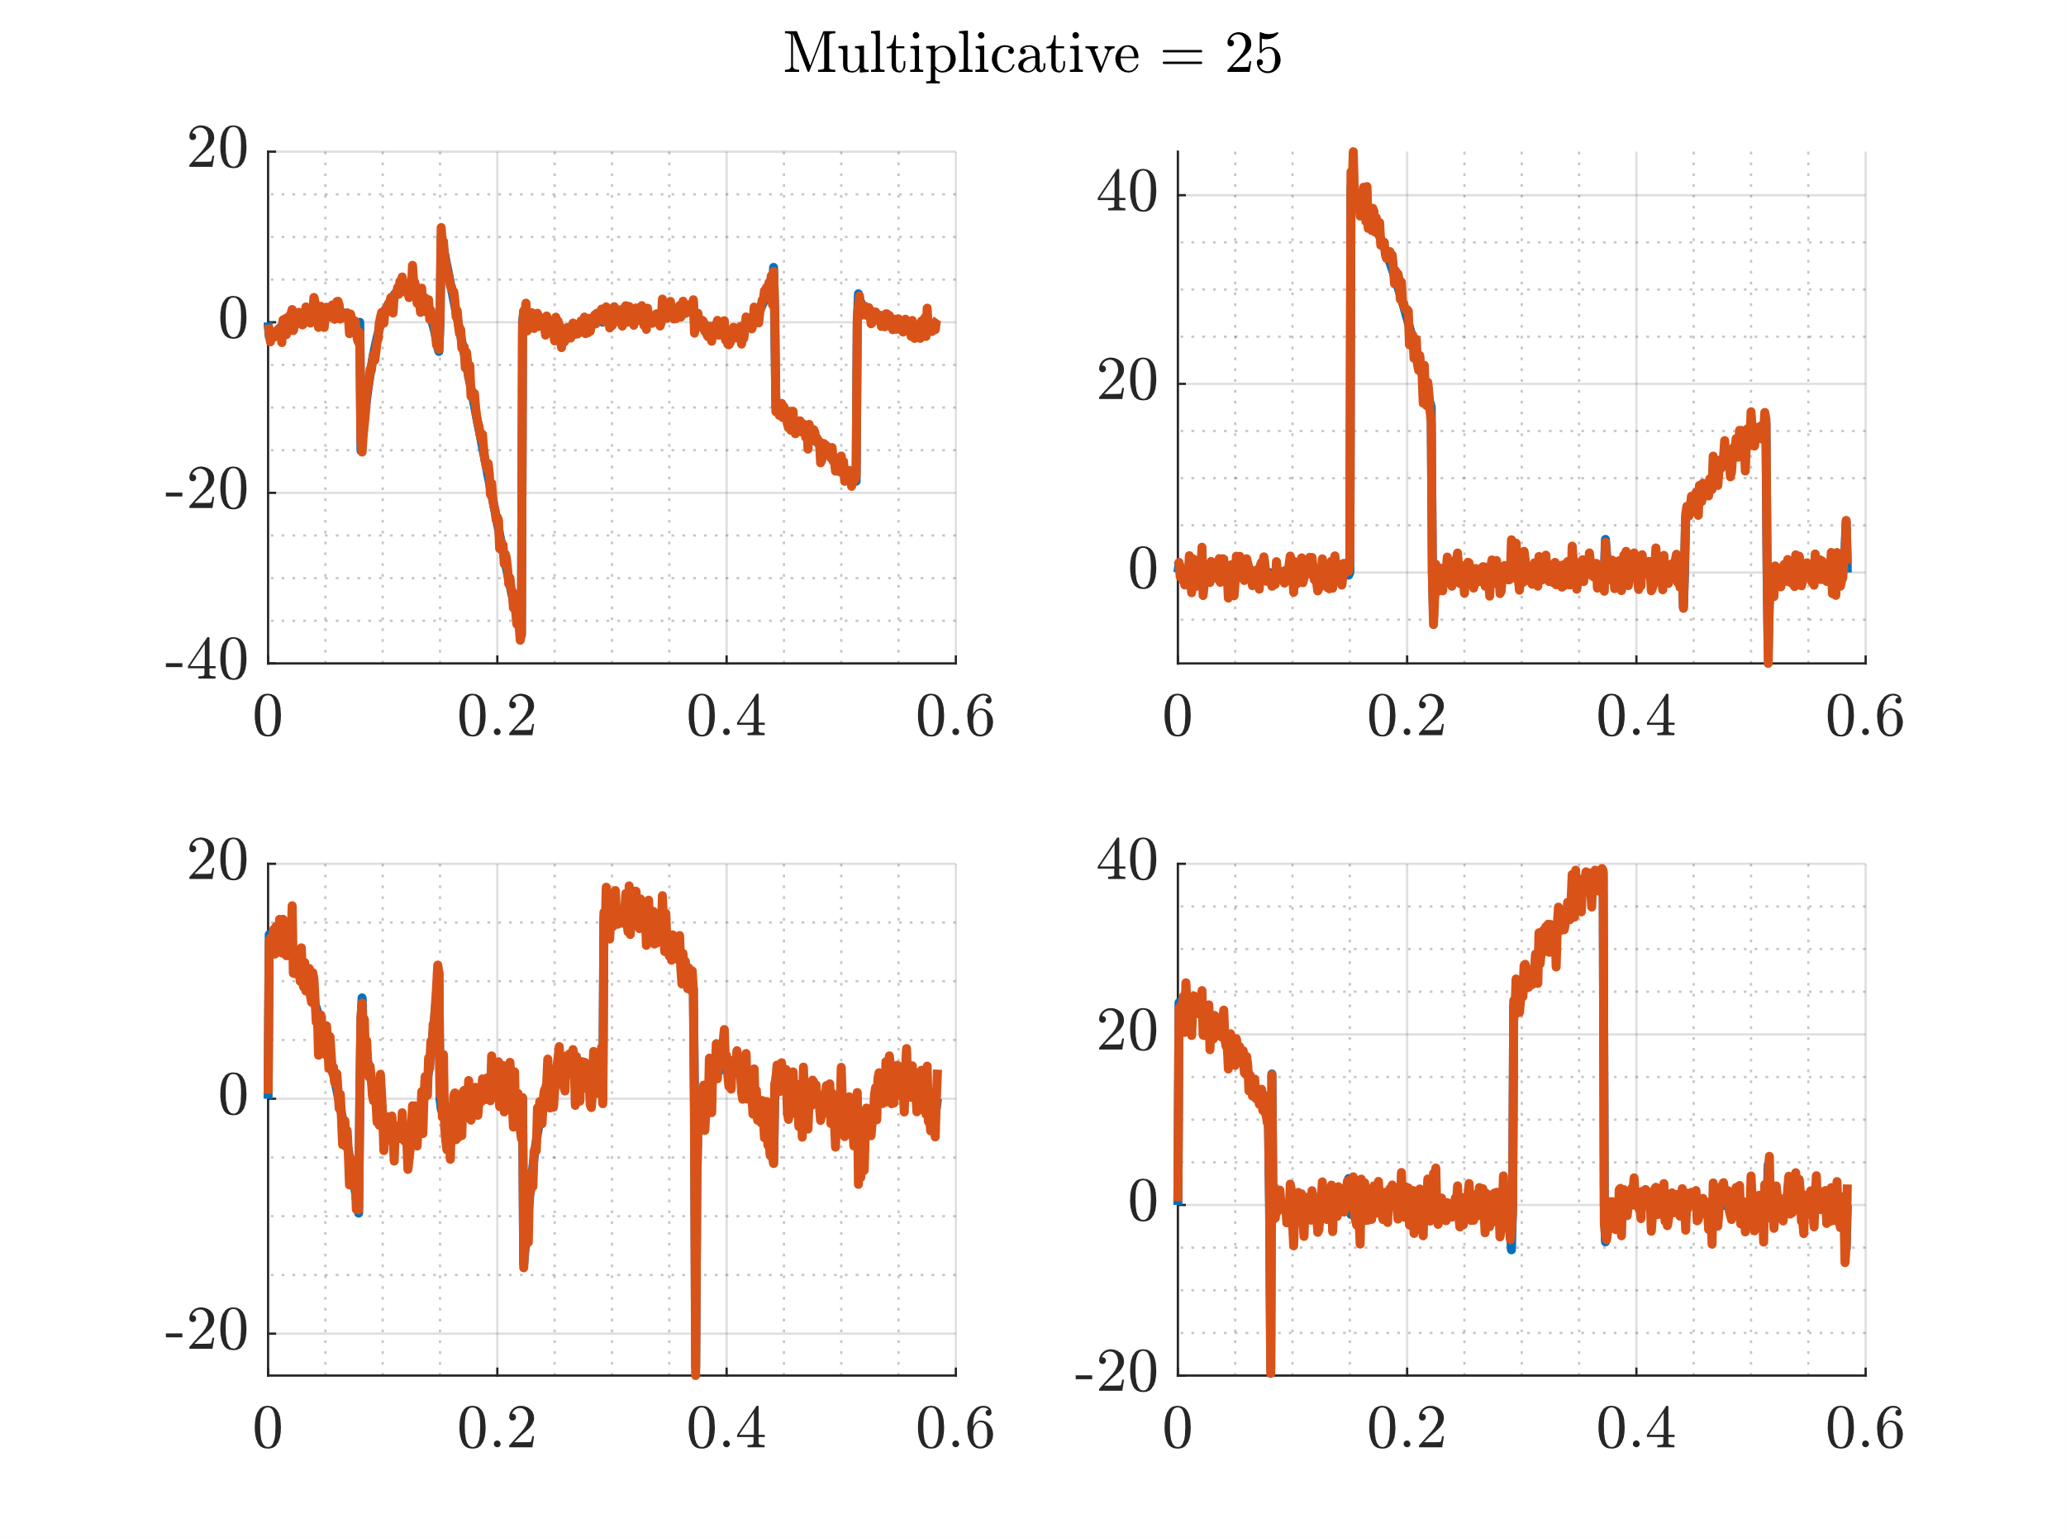
Add Noise Realization

Slide 16
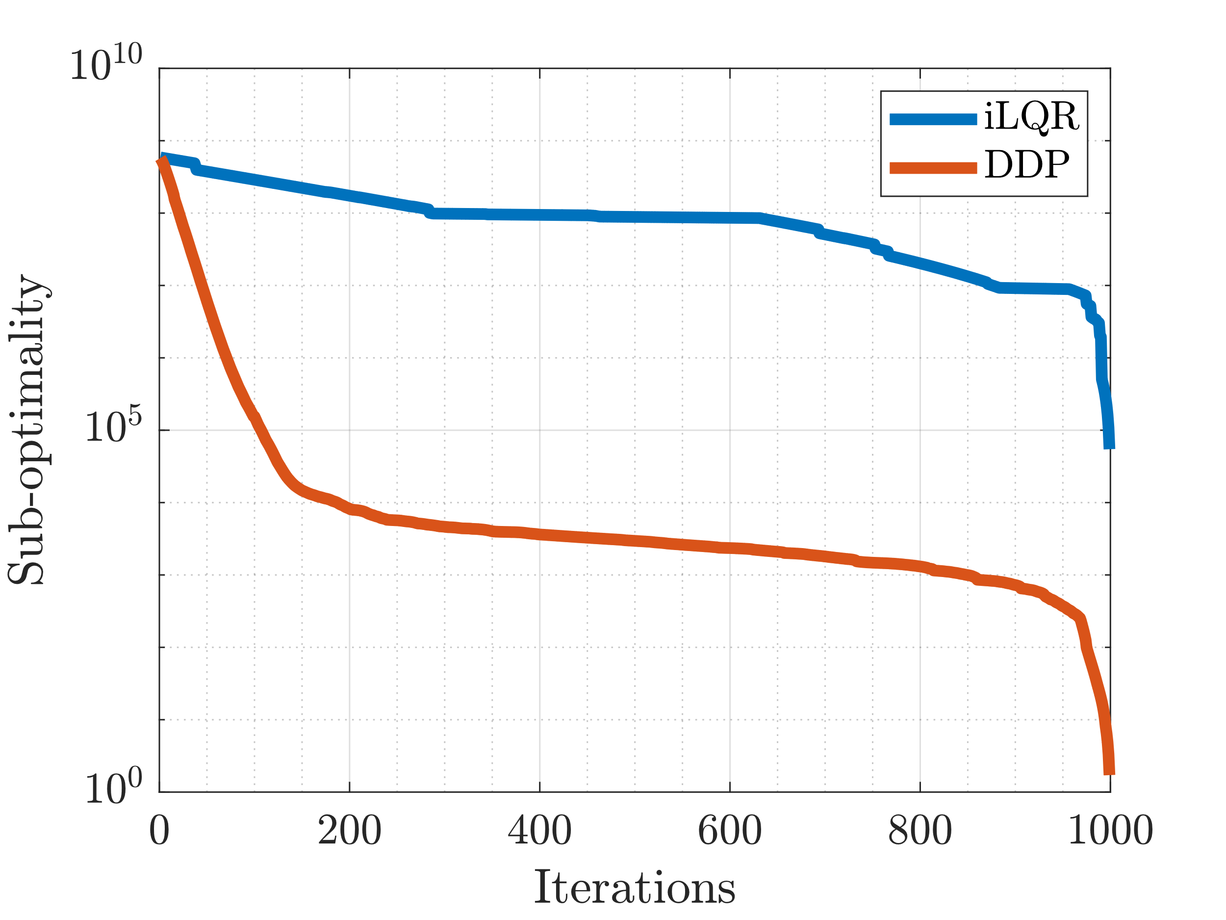
Suboptimality
Suboptimality = semiology(V – Vbar (end))

Slide 17
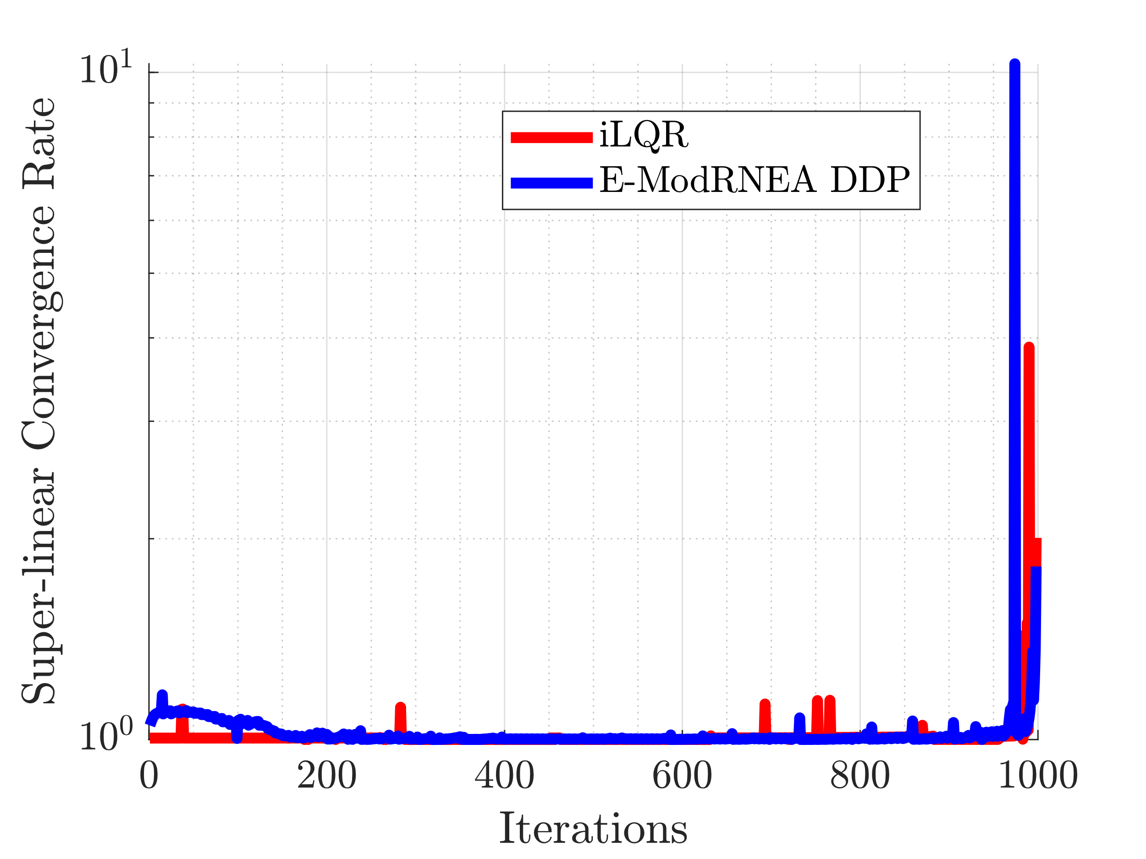
Convergence Rate: Superlinear

Slide 18
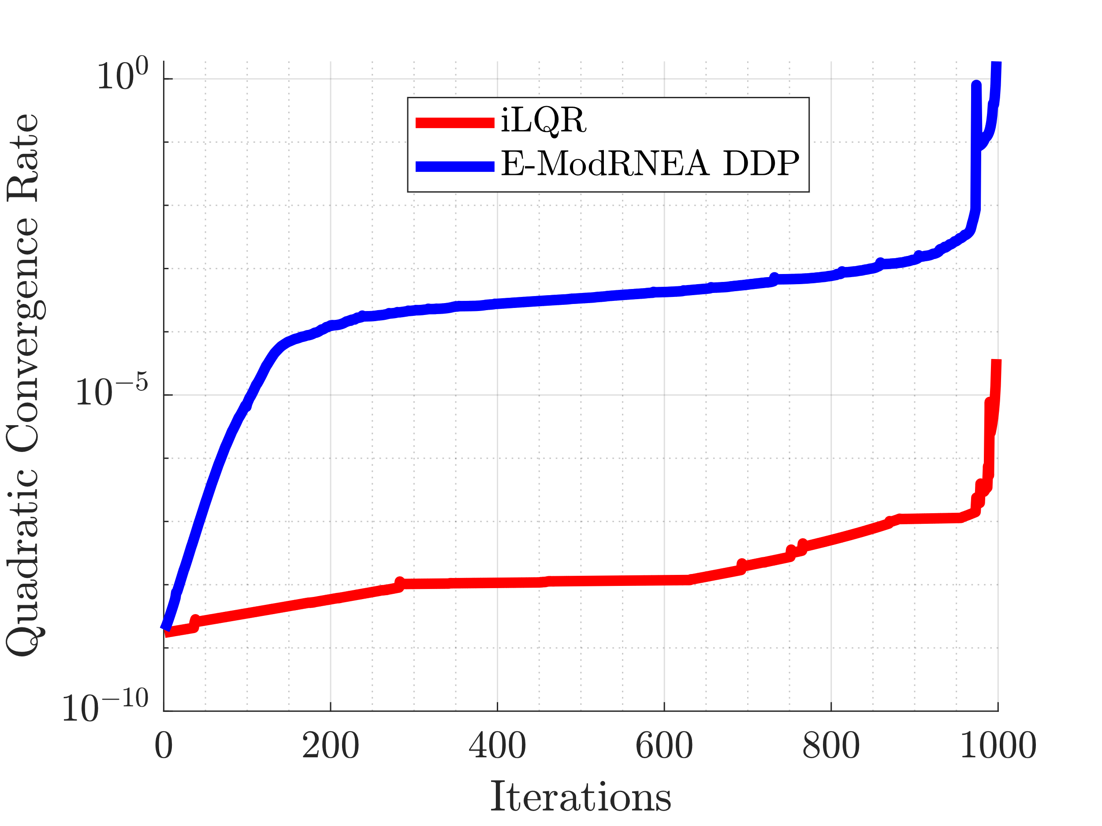
Convergence Rate: Quadratic

Slide 19
Paper
Writing results section
Figures from this presentation

